Slide 1

A Novel Application of Small Area Estimation Methodology to Study Child-Trafficked Population in Sierra Leone
Present by Hui Yi
Joint Statistical Meetings
08/07/2024
Co-authors: Gauri Datta, Jiacheng Li, Jody Clay-Warner, David Okech

Slide 2


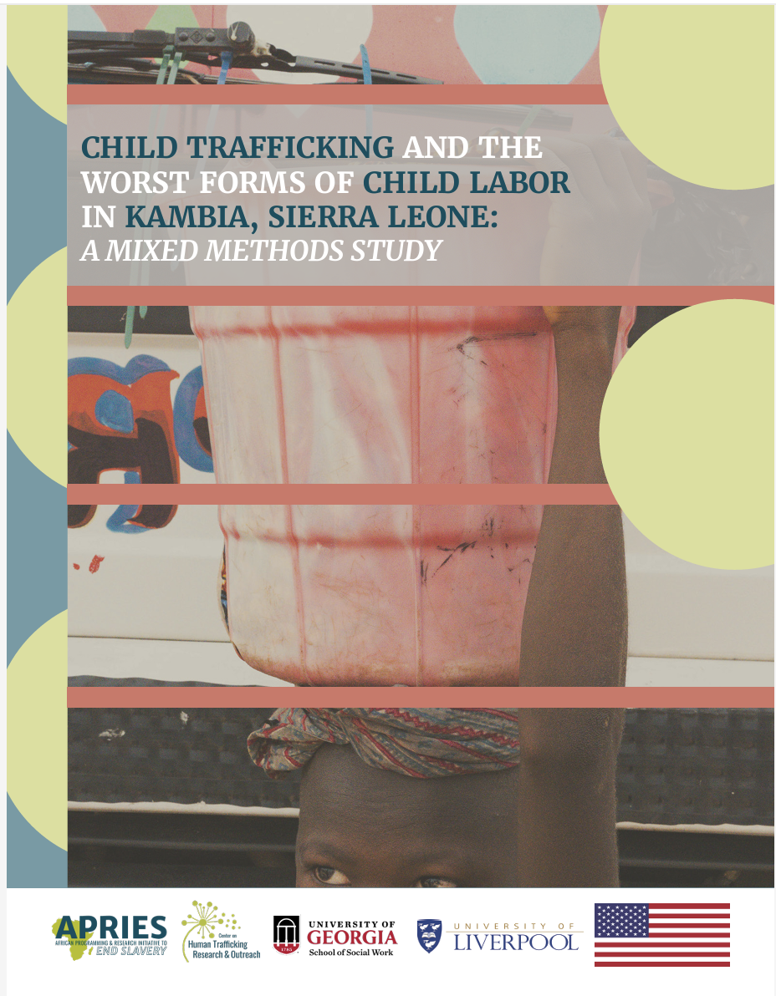
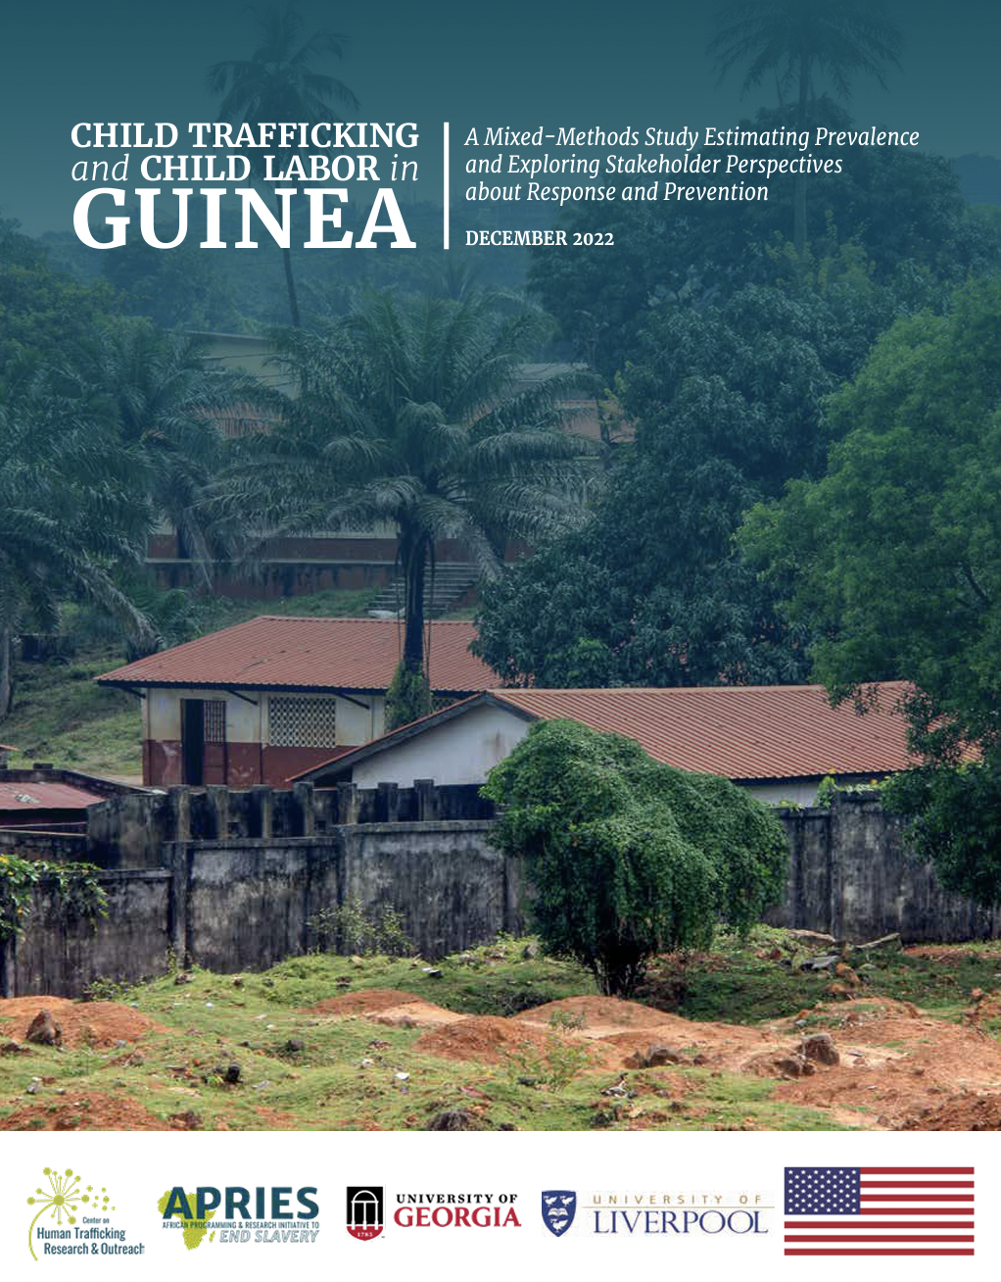



About CenHTRO
CenHTRO Reports
What: Center on Human Trafficking Research and Outreach
Where: School of Social Work, University of Georgia
When: Founded in 2021
Who: Founded by Dr. David Okech (Professor, School of Social Work, Director, CenHTRO and PRIF)
GENERAL INQUIRIES: cenhtro@uga.edu
(706) 542-0067
Prevalence reduction innovation forum (PRIF)
This research was funded by a grant from the United States Department of State SSJTIP18CA0015. The opinions, findings and conclusions stated herein are those of the author[s] and do not necessarily reflect those of the United States Department of State.
Notes:
Founded around 2019 by Dr. David Okech (Professor, School of Social Work, Director of CenHTRO) at University of Georgia
Since founding, we completed 4 large-scale, baseline human trafficking prevalence studies in West Africa, including 2 studies in Sierra Leone, 1 in Guinea, and 1 in Senegal.
We developed the Prevalence Reduction Innovation Forum (or PRIF) which involved partnerships with researchers to test prevalence estimation methods for human trafficking in 6 countries and 7 studies.
Currently we are researching labor trafficking among youth and young adults in the Southern African region, especially Malawi and Zambia.

Slide 3
Background
Human Trafficking
Human trafficking (HT), which involves the exploitation of a person for labor, services, commercial sex, is the second or third human crime industry in the world with an estimate of 40 million victims in 2016 in the globe (International Labour Organization, 2017).
Child Traffcking in Sierra Leone
The Center on Human Trafficking Research & Outreach (CenHTRO) team at the University of Georgia, funded by the US Department of State, conducted the baseline study of Child trafficking (CT) for the three districts of Eastern Province of Sierra Leone in 2020 (Okech et al., 2021).
Specifically, the prevalence of CT for the three hotspot districts of Sierra Leone were enabled through administering on a sample of 3,070 households survey across the three districts based on an equal probability selection method (which waives the need of post sample weighting).
Notes:
The three districts in the Eastern Province of Sierra Leone were identified as hotspots due to several reasons:
The 2019 United Nations Development Programme (UNDP) report indicated the Eastern Province was one of the poorest regions in Sierra Leone, with the highest incidence (18.1%) and gap (21.4%) of extreme poverty, and the second highest for severity (6.7%).
With a higher child poverty headcount than the national average, 71% of children in the Eastern region were reported to experiencing at least one deprivation of capabilities, making them more vulnerable than those of the other regions. (Statistics Sierra Leone (Stats SL) & UNICEF, 2018).
Among districts in the Eastern region, the child poverty rate is the highest in Kailahun (78%), followed by Kono (73%) and lowest in Kenema (64%; Statistics Sierra Leone, 2019).

Slide 4
Introduction
District-Level Prevalence Estimation of CT in Sierra Leone
The district-level prevalence rates of CT were:
26.6% (51,948) in Kenema
32.9% (60,866) in Kailahun
and 45.7% (76,823) in Kono
Objectives of This Study
In this study, we filled the knowledge gap about the prevalence of CT in the small areas (e.g., at lower administrative level) within each district by adopting the Small Area Estimation (SAE) methods.
Specifically, we applied two SAE methods, Hierarchical Bayes (HB) and Emprical Best Linear Unbiased Prediction (EBLUP) methods, on the 40 chiefdoms, a lower administrative unit than the districts, for the prevalence estimation for CT.
Notes:
This study is a continuation of the CT study conducted in the three hotspot districts, i.e., Kailahun, Kenema, and Kono, of the Eastern province of SL, where 3,070 households were surveyed based on an equal probability selection method, which waives the need of post sample weighting.
We filled the knowledge gap about the prevalence of CT in the small areas (e.g., at lower administrative level) within each district by adopting the Small Area Estimation (SAE) methods.
Specifically, we applied two SAE methods, Hierarchical Bayes and EBLUP methods on the 40 chiefdoms of the three districts. We found that the two SAE methods have close performance in the prevalence estimation of CT, which echoes with the previous findings. Large variation and uneven distribution of CT prevalence rates across the chiefdoms was observed. Six chiefdoms which shared the commonality of small sample sizes, received significant improvement in accuracy in the CT prevalence rates through the SAE technique. Age and asset ownership, which represents demographic and financial characteristics of the households in the small areas, were identified as push and pull factors for the CT prevalence. This work will inform the programming and resource allocations and policy making towards the efforts to eliminate CT in SL.

Slide 5

Methods
Small Area Estimation Method: Model Setup and Assumptions
SAE has been widely applied in developing estimates of useful human characteristics for many demographic groups at the regional or sub-national level, which are often referred to as small areas or small domains (Rao & Molina, 2015).
A popular model in small area estimation is the mixed-effect Fay-Herriot model (1979), which can be expressed as
$$y_{i}= θ_{i}+e_{i}$$
$$θ_{i}=x_{i}^{T}β+v_{i}, i=1,⋯,m$$
where
$y_{i}$ is related to $θ_{i}$ via the first part of the model, known as the sampling model. In our case, it is the direct estimate CT of the ith chiefdom
$θ_{i}$ is related to the covariates via the second part of the model, known as the linking model
The linking model suggests a multiple linear regression model for the latent $θ_{i}$ on $x_{i}$, which is a vector of known covariates, e.g., age and asset ownership in the chiefdoms
$β$ is an unknown vector of regression coefficients
$v_{i}$'s are area-specific random effects, and $v_{i}∼N\left(0,A\right)$, where variance A is unknown.
$e_{i}$'s are sampling errors. We also assume $e_{i}∼N\left(0,D_{i}\right)$, and $v_{i}⫫e_{i}$, the sampling variances $D_{i}$'s are assumed known. We approximated the variance $D_{i}′s$ for the CT rate, by $\overline{p}⋅\left(1−\overline{p}\right)/n_{i}$, where $\overline{p}=$0.33 is the observed average CT rate for all three districts, and $n_{i}$ is the number of children in the sample from the $i$th chiefdom.
Our target is estimating the small area means $θ_{i}=x_{i}^{T}β+v_{i}, 1≤i≤m.$

Slide 6
Data
Data Sampling
Administratively, Sierra Leone is divided into provinces. Each province is subdivided into districts, each district is further divided into chiefdoms.
It resulted in 905 households across 13 chiefdoms in Kailahun, 1,220 households across 13 chiefdoms in Kenema and 945 households across 14 chiefdoms in Kono, respectively.
The small area unit is chiefdom. The target population was household children in the age range of 5-17.
Quantitative Measures of CT
Okech et al., (2020) provided details of statistical and operational definitions of child trafficking and were adopted in this study.
Children were classified as victims of child trafficking if, in the past year, their labor conditions were characterized by any of the following: (1) hazardous labor sectors, (2) hazardous labor activities, and (3) force, fraud, and coercion.
Covariates
We included demographic, social, and financial variables as potential explanatory variables.
Two variables, age and asset ownership, indicated significant relationship with CT in the chiefdoms (with p-value < 0.05) with the prevalence of CT using stepwise selection based on the AIC criteria.

Slide 7
Results
Kailahun
District | Chiefdoms | Point Estimates of CT |  |  | Sampling SDs |  |  | CI of survey |  | Credible Interval of HB |  | CI of EBLUP-ML |  | Sample | Extent of
 |  | Prevalence Rates |  |  |  |  |  |  |  |  |  |  |  | Sizes | Shrinkage
 |  | Survey | HB | EBLUP | Survey | HB | EBLUP-ML | Lower | upper | lower | upper | lower | upper
Kailahun (CT rate: 32.9%) | 1:Dea | 0.842 | 0.830 | 0.829 | 0.037 | 0.037 | 0.037 | 0.769 | 0.915 | 0.757 | 0.903 | 0.757 | 0.901 | 158 | 0.034
 | 2:Jawie | 0.253 | 0.255 | 0.255 | 0.037 | 0.036 | 0.036 | 0.181 | 0.325 | 0.184 | 0.326 | 0.184 | 0.327 | 162 | 0.033
 | 3:Kissi Kama | 0.675 | 0.631 | 0.625 | 0.074 | 0.071 | 0.070 | 0.529 | 0.821 | 0.491 | 0.77 | 0.487 | 0.762 | 40 | 0.122
 | 4:Kissi Teng | 0.139 | 0.147 | 0.147 | 0.034 | 0.034 | 0.034 | 0.072 | 0.206 | 0.081 | 0.213 | 0.081 | 0.214 | 187 | 0.029
 | 5:Kissi Tongi | 0.226 | 0.233 | 0.235 | 0.041 | 0.040 | 0.040 | 0.146 | 0.306 | 0.155 | 0.311 | 0.156 | 0.313 | 133 | 0.040
 | 6:Kpeje Bongre | 0.553 | 0.543 | 0.542 | 0.046 | 0.045 | 0.045 | 0.462 | 0.644 | 0.456 | 0.629 | 0.453 | 0.631 | 103 | 0.051
 | 7: Kpeje West | 0.500 | 0.517 | 0.519 | 0.166 | 0.129 | 0.129 | 0.174 | 0.826 | 0.263 | 0.769 | 0.267 | 0.772 | 8 | 0.409
 | 8: Luawa | 0.133 | 0.135 | 0.135 | 0.020 | 0.020 | 0.020 | 0.094 | 0.172 | 0.096 | 0.175 | 0.096 | 0.175 | 547 | 0.010
 | 9: Malema | 0.789 | 0.785 | 0.784 | 0.108 | 0.097 | 0.098 | 0.578 | 1.000 | 0.592 | 0.974 | 0.591 | 0.976 | 19 | 0.226
 | 10: Mandu | 0.165 | 0.169 | 0.170 | 0.042 | 0.041 | 0.041 | 0.083 | 0.247 | 0.088 | 0.249 | 0.090 | 0.250 | 127 | 0.042
 | 11: Njaluahun | 0.569 | 0.564 | 0.564 | 0.033 | 0.033 | 0.032 | 0.505 | 0.633 | 0.503 | 0.627 | 0.501 | 0.627 | 209 | 0.026
 | 12: Penguia | 0.425 | 0.433 | 0.434 | 0.074 | 0.070 | 0.070 | 0.279 | 0.571 | 0.294 | 0.572 | 0.297 | 0.571 | 40 | 0.122
 | 13: Upper Bambara | 1.000 | 0.955 | 0.950 | 0.149 | 0.129 | 0.131 | 0.709 | 1(1.291) | 0.702 | 1(1.205) | 0.694 | 1(1.206) | 10 | 0.357
Notes:
As we mentioned earlier, two SAE approaches were applied, namely. Hierarchical Bayes and EBLUPs methods.
The Hierarchical Bayes was implemented using Hamiltonian Monte Carlo method via R programming package rstan. The flat priors were applied for A and coefficients of betas. After the initial 5000 burn-in iterations, 20,000 iterations were run on four concurrent Hamiltonian Monte Carlo chains. Combining the four chains and retaining every 10th iteration yielded a posterior sample size of 8,000.
We present the Bayes estimates, their related posterior standard deviations, and 95% credible ranges in the following tables, columns 3, 6, 8 and 9, respectively. In addition, we presented EBLUP estimations, their Root Mean Squared Prediction Errors (RMSPEs), and the estimated 95% confidence intervals (Columns 4, 7, 10, and 11 individually)
The shrinkages diminish as sample sizes decrease, and for the majority of chiefdoms, they are small (0.2), with the exception of six chiefdoms (which we highlighted in bold in the tables).
As mentioned earlier, for the chiefdoms with smaller samples the sampling variances $D_{i}$’s are large, and the corresponding direct estimators are substantially shrunk towards the regression function.
Overall, the CT rate in Kailahun is 32.9%. Within the district, the CT rate at the chiefdom level varies from 13.3% (Luawa) to 100% (Upper Bambara), with a coefficient of variation of 0.084 among the chiefdoms of Kailahun.
Eight of thirteen chiefdoms had higher CT rates than the total district average.
Except for two chiefdoms (i.e., 7: Kpeje West and 12: Penguia), the rest of the chiefdoms have CT rates significantly different from the district-level CT rate.

Slide 8
Results
Kenema
District | Chiefdoms | Point Estimates of CT |  |  | Sampling SDs |  |  | CI of survey |  | Credible Interval of HB |  | CI of EBLUP-ML |  | Sample | Extent of
 |  | Prevalence Rates |  |  |  |  |  |  |  |  |  |  |  | Sizes | Shrinkage
 |  | Survey | HB | EBLUP | Survey | HB | EBLUP-ML | Lower | upper | lower | upper | lower | upper
Kenema (CT rate: 26.6%) | 14: Dama | 0.154 | 0.16 | 0.161 | 0.028 | 0.027 | 0.027 | 0.1 | 0.208 | 0.107 | 0.212 | 0.107 | 0.214 | 292 | 0.019
 | 15: Dodo | 0.61 | 0.58 | 0.575 | 0.061 | 0.059 | 0.059 | 0.49 | 0.73 | 0.464 | 0.695 | 0.46 | 0.691 | 59 | 0.086
 | 16: Gaura | 0.673 | 0.656 | 0.652 | 0.067 | 0.064 | 0.064 | 0.541 | 0.805 | 0.529 | 0.781 | 0.527 | 0.777 | 49 | 0.102
 | 17: Gorama Mende | 0.328 | 0.329 | 0.329 | 0.03 | 0.03 | 0.03 | 0.268 | 0.388 | 0.271 | 0.388 | 0.27 | 0.388 | 238 | 0.023
 | 18: Kandu Leppiama | 0.443 | 0.437 | 0.435 | 0.048 | 0.046 | 0.047 | 0.349 | 0.537 | 0.345 | 0.527 | 0.344 | 0.526 | 97 | 0.054
 | 19: Kenema City | 0.259 | 0.259 | 0.259 | 0.016 | 0.016 | 0.016 | 0.228 | 0.29 | 0.228 | 0.289 | 0.228 | 0.29 | 887 | 0.006
 | 20: Koya | 0.191 | 0.194 | 0.195 | 0.057 | 0.054 | 0.055 | 0.079 | 0.303 | 0.088 | 0.301 | 0.087 | 0.303 | 68 | 0.075
 | 21: Lower Bambara | 0.245 | 0.246 | 0.247 | 0.02 | 0.02 | 0.02 | 0.206 | 0.284 | 0.208 | 0.285 | 0.207 | 0.286 | 548 | 0.01
 | 22: Malegohun | 0.27 | 0.275 | 0.276 | 0.042 | 0.041 | 0.041 | 0.188 | 0.352 | 0.195 | 0.356 | 0.196 | 0.357 | 126 | 0.042
 | 23: Nongowa | 0.304 | 0.305 | 0.305 | 0.024 | 0.023 | 0.023 | 0.258 | 0.35 | 0.26 | 0.353 | 0.26 | 0.351 | 398 | 0.014
 | 24: Simbaru | 0.435 | 0.434 | 0.432 | 0.069 | 0.066 | 0.066 | 0.299 | 0.571 | 0.302 | 0.565 | 0.303 | 0.561 | 46 | 0.108
 | 25: Small Bo | 0.082 | 0.09 | 0.091 | 0.033 | 0.032 | 0.032 | 0.018 | 0.146 | 0.026 | 0.155 | 0.028 | 0.155 | 207 | 0.026
 | 26: Tunkia | 0.214 | 0.228 | 0.229 | 0.126 | 0.108 | 0.108 | 0 | 0.46 | 0.014 | 0.439 | 0.018 | 0.441 | 14 | 0.284
Notes:
Similarly, Kenema's overall CT rate is 26.6%, with the lowest CT rate in Small Bo at 8.2% and the highest CT rate in Gaura at 67.3%, with a variance of 0.030 among chiefdoms.
Seven of thirteen chiefdoms have CT rates higher than the district average.
Except for chiefdom 19: Kenema City, 20: Koya, 21: Lower Bambara, 22: Malegohun, 23: Nongowa and 26: Tunkia, the rest of the chiefdoms have CT rates significantly different from the district level prevalence rate.

Slide 9
Results
Kono
District | Chiefdoms | Point Estimates of CT |  |  | Sampling SDs |  |  | CI of survey |  | Credible Interval of HB |  | CI of EBLUP-ML |  | Sample | Extent of
 |  | Prevalence Rates |  |  |  |  |  |  |  |  |  |  |  | Sizes | Shrinkage
 |  | Survey | HB | EBLUP | Survey | HB | EBLUP-ML | Lower | upper | lower | upper | lower | upper
Kono (CT rate: 45.7%) | 27: Fiama | 0.086 | 0.113 | 0.116 | 0.062 | 0.059 | 0.059 | 0 | 0.207 | 0 | 0.228 | 0 | 0.232 | 58 | 0.087
 | 28: Gbane | 0.711 | 0.708 | 0.707 | 0.07 | 0.067 | 0.067 | 0.574 | 0.848 | 0.578 | 0.834 | 0.576 | 0.838 | 45 | 0.11
 | 29: Gbane Kandor | 0.325 | 0.323 | 0.323 | 0.074 | 0.071 | 0.07 | 0.179 | 0.471 | 0.185 | 0.46 | 0.185 | 0.461 | 40 | 0.122
 | 30: Gbense | 0.53 | 0.529 | 0.529 | 0.052 | 0.05 | 0.05 | 0.429 | 0.631 | 0.432 | 0.629 | 0.431 | 0.627 | 83 | 0.063
 | 31: Gorama Kono | 0.2 | 0.261 | 0.27 | 0.105 | 0.095 | 0.094 | 0 | 0.406 | 0.072 | 0.445 | 0.086 | 0.453 | 20 | 0.217
 | 32: Kamara | 0.426 | 0.425 | 0.425 | 0.064 | 0.061 | 0.061 | 0.301 | 0.551 | 0.307 | 0.546 | 0.306 | 0.545 | 54 | 0.093
 | 33: Koidu City | 0.373 | 0.372 | 0.372 | 0.021 | 0.021 | 0.021 | 0.331 | 0.415 | 0.33 | 0.415 | 0.33 | 0.414 | 485 | 0.011
 | 34: Lei | 0.92 | 0.866 | 0.859 | 0.066 | 0.063 | 0.063 | 0.79 | 1.05 | 0.739 | 0.994 | 0.735 | 0.983 | 50 | 0.1
 | 35: Mafindor | 0.419 | 0.428 | 0.429 | 0.06 | 0.057 | 0.058 | 0.302 | 0.536 | 0.315 | 0.54 | 0.316 | 0.542 | 62 | 0.082
 | 36: Nimikoro | 0.485 | 0.483 | 0.482 | 0.036 | 0.035 | 0.035 | 0.415 | 0.555 | 0.415 | 0.55 | 0.413 | 0.552 | 171 | 0.031
 | 37: Nimiyama | 0.589 | 0.585 | 0.584 | 0.042 | 0.041 | 0.041 | 0.506 | 0.672 | 0.506 | 0.667 | 0.503 | 0.665 | 124 | 0.043
 | 38: Sandor | 0.656 | 0.649 | 0.648 | 0.032 | 0.032 | 0.032 | 0.593 | 0.719 | 0.586 | 0.714 | 0.586 | 0.711 | 212 | 0.025
 | 39: Soa | 0.233 | 0.237 | 0.238 | 0.044 | 0.042 | 0.043 | 0.147 | 0.319 | 0.153 | 0.321 | 0.154 | 0.322 | 116 | 0.046
 | 40: Tankoro | 0.353 | 0.402 | 0.407 | 0.114 | 0.101 | 0.1 | 0.129 | 0.577 | 0.202 | 0.602 | 0.211 | 0.603 | 17 | 0.246
Notes:
45.7% is the average CT rate for the Kono district.
The chiefdom Fiama has the lowest CT rate at 8.6%, while Lei has the highest CT rate at 92.0%, with a variance of 0.049 across chiefdoms.
Six of fourteen chiefdoms have CT rates that are higher than the overall average. The majority of the chiefdoms have significantly different prevalence of CT than the district-level prevalence, except for 5 chiefdoms (i.e., 30: Gbense, 32: Kamara, 35: Mafindor, 36: Nimikoro and 40: Tankoro).
The greater the shrinkage value, the greater the reduction in the variance and width of confidence interval.
Six chiefdoms, which share the commonality of bearing small sample sizes and were bolded here, have the largest improvement in sampling variances reduction (­$\left(D_{i}−(Posterior variance) or MSE\right)/D_{i}$). They are 39.61%, 19.33%, 25.04%, 26.53%, 18.14%, and 21.51%, respectively by using HB method, and 39.61%, 17.66%, 22.70%, 26.53%, 19.85%, and 23.05% improvement, respectively by using EBLUP method.
The point estimates and standard deviations of HB and EBLUPs are extremely close to one another, as are the sampling variance reductions. However, HB provides the uncertainties of parameter estimates automatically, whereas the EBLUPs require approximations. Moreover, in some cases, estimates of MSE of EBLUPs can be negative, but posterior variances are invariably positive.

Slide 10
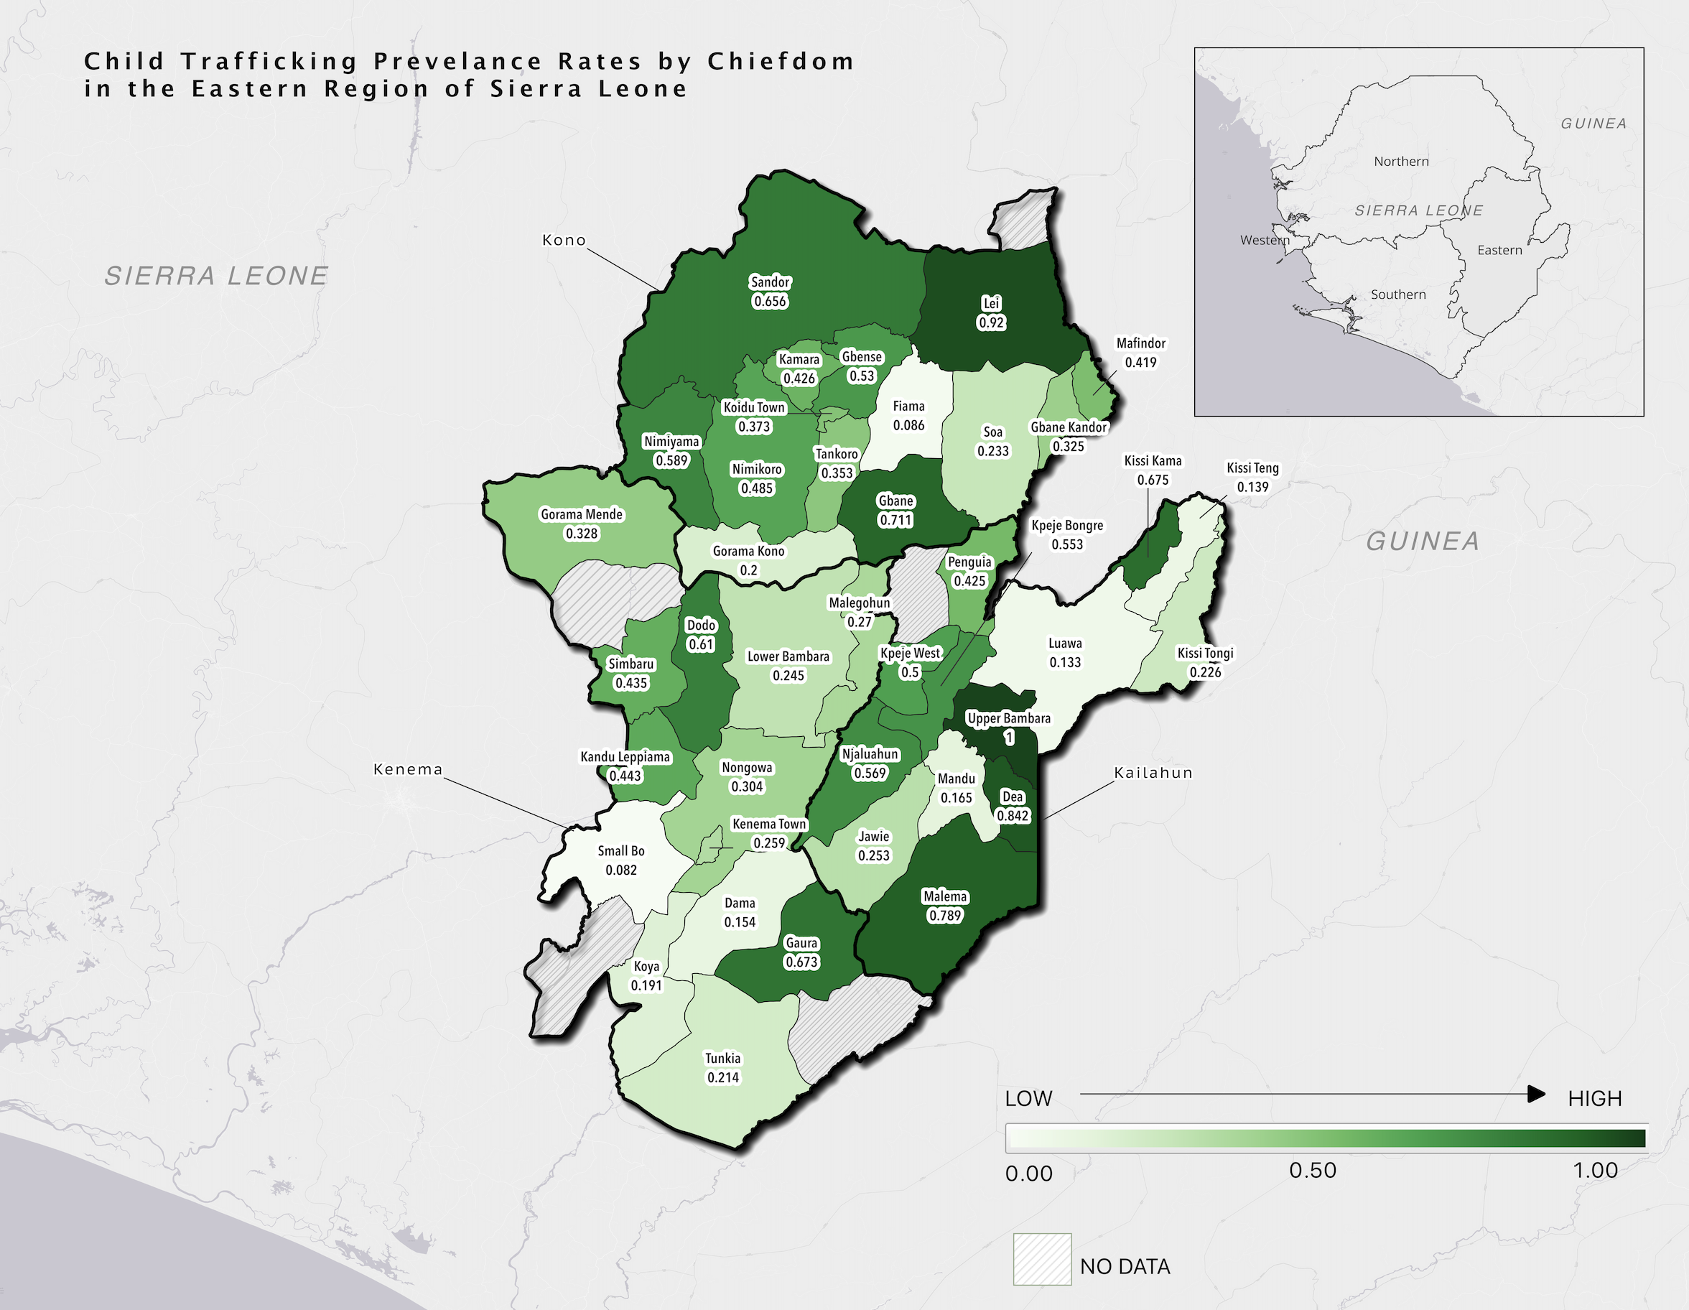

Results
Notes:
This map illustrates the direct estimations of CT prevalence of the 40 chiefdoms in the three district of Eastern province of Sierra leone.
The darker green indicates a higher rate of CT prevalence.
It shows that the prevalence rates have geographic relationships.
In the future, small area spatial models can be exploited to further investigate the spatial relationships and patterns of the CT prevalence across the small areas.

Slide 11

Results
We approximated $D_{i}$the variance of CT rate in small area $i$by
$$D_{i}= \frac{\overline{p}⋅\left(1−\overline{p}\right)}{n_{i}}$$
where $\overline{p}=$0.33 is the observed average CT rate across the three districts, and $n_{i}$ is the number of children from the $i^{th}$chiefdom. It can be shown that
$D_{i}=\frac{s}{n_{i}}$ (1)
We denote the mean of CT rate in small area $j$b$y \hat{θ_{j}}$. The posterior variance of $\hat{θ_{j}}$can be approximated by
$V\left(\hat{θ_{j}}\right) ≈ \frac{D_{j} \hat{A}}{D_{j}+\hat{A}}= \frac{s}{n_{j}^{∗}}$ (2)
Plugging equation (1) into (2), we can get
$$n_{j}^{∗}\hat{A}=s+n_{j}^{∗}\hat{A}$$
$$n_{j}^{∗}= \frac{s}{\hat{A}}+n_{j}$$
Here s = $\overline{p}⋅\left(1−\overline{p}\right)$=0.33*(1-0.33)=0.22, and $\hat{A}=0.04$ for the HB. Then $n_{j}=n_{j}^{∗}−5.5 ≈n_{j}^{∗}−5$.
Notes:
In this sense, an average of 5 samples per chiefdom can be saved which comes to the same accuracy using the HB model (in terms of mean and variance of CT estimates).
We have total of six Chiefdoms with small sample sizes. They could contribute to 20-40% reduction in sample size to be surveyed due to utilizing the SAE methods. This indicates that the SAE models, either HB or EBLUP, can be used to save money by reducing sample sizes for those distant chiefdoms.

Slide 12
Conclusions
We found that the two SAE methods have close performance in the prevalence estimation of CT, which echoes with the previous findings.
Large variation and concentration patterns of CT prevalence rates across the chiefdoms was observed. Six chiefdoms which shared the commonality of small sample sizes, received significant improvement in accuracy in the CT prevalence rates through the SAE technique.
Age and asset ownership, which represents demographic and financial characteristics of the households in the small areas, were identified as push and pull factors for the CT prevalence.
This work will inform the programming and resource allocations and policy making towards the efforts to eliminate CT in SL.

Slide 13







THANK YOU
Research Funder and Partners

Slide 14
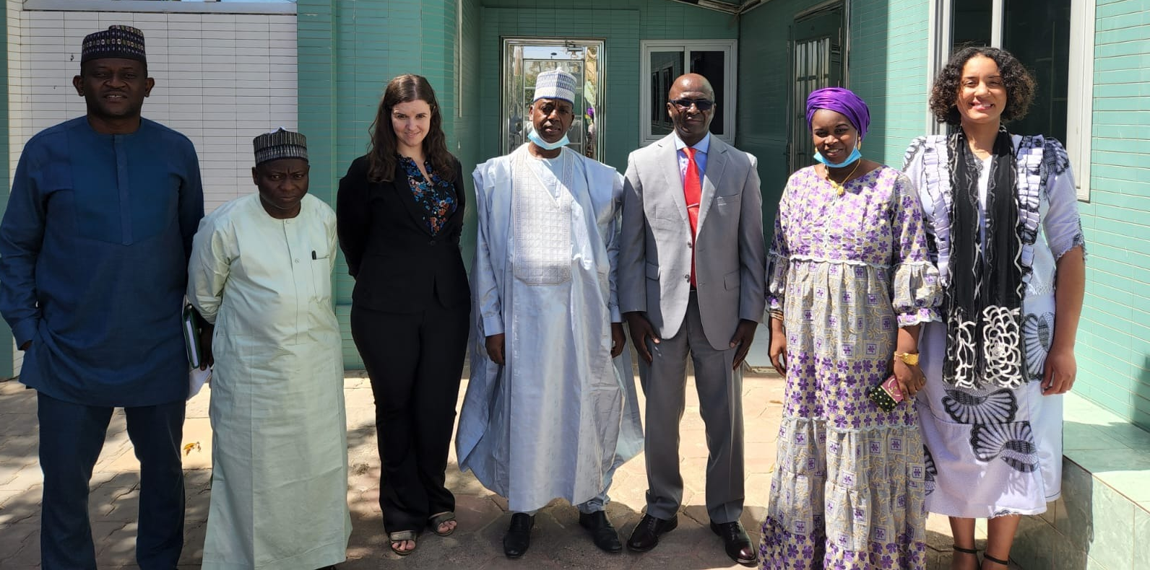
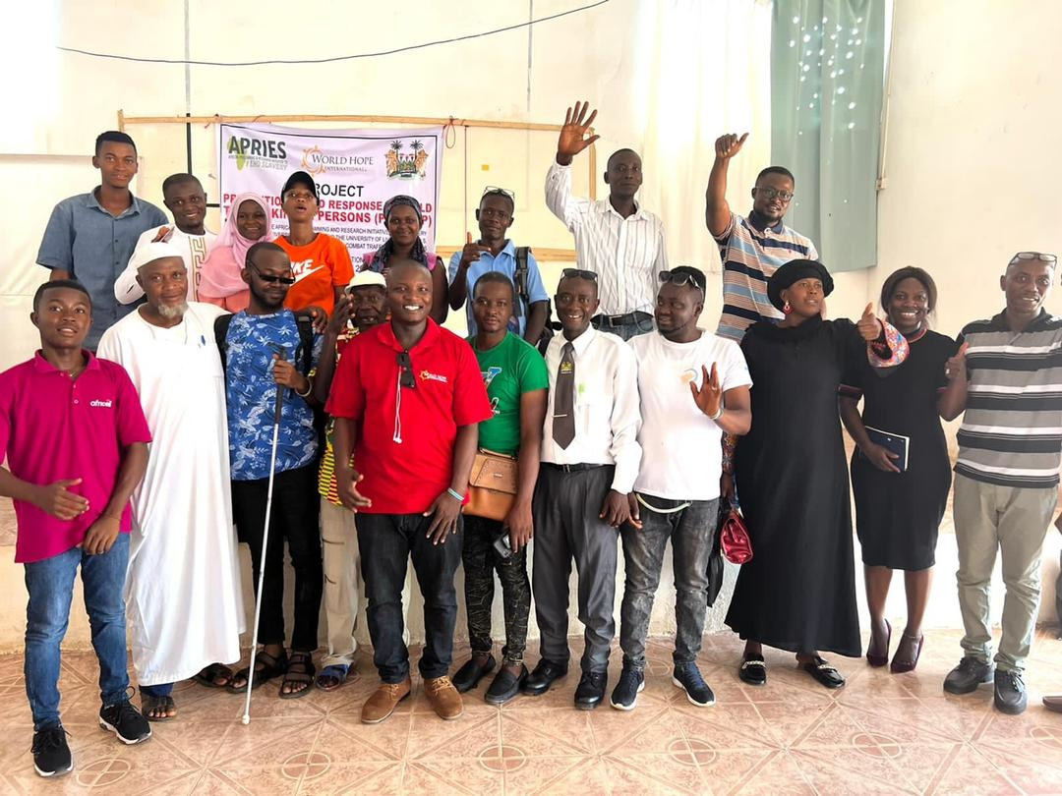
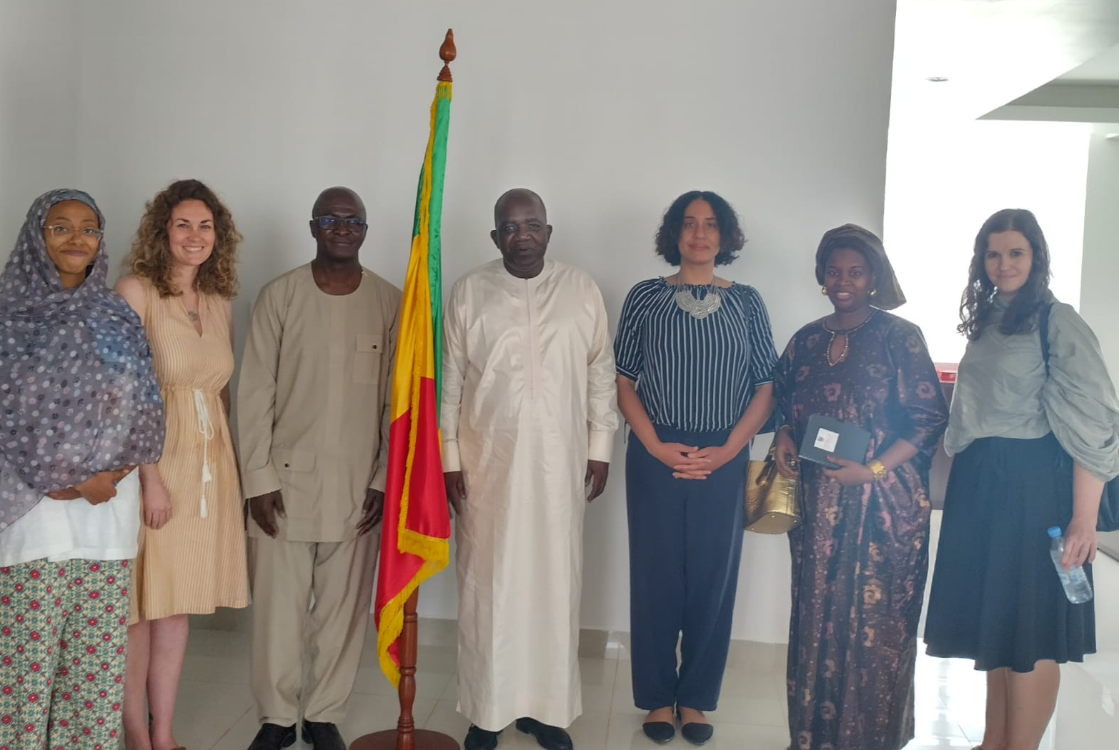
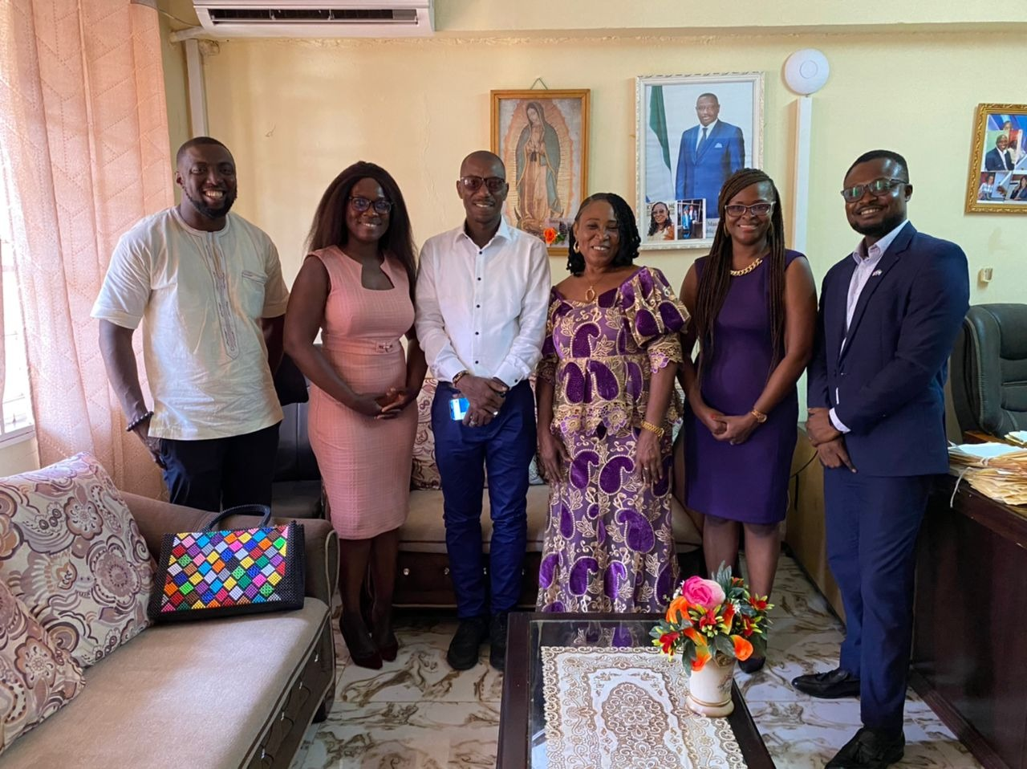
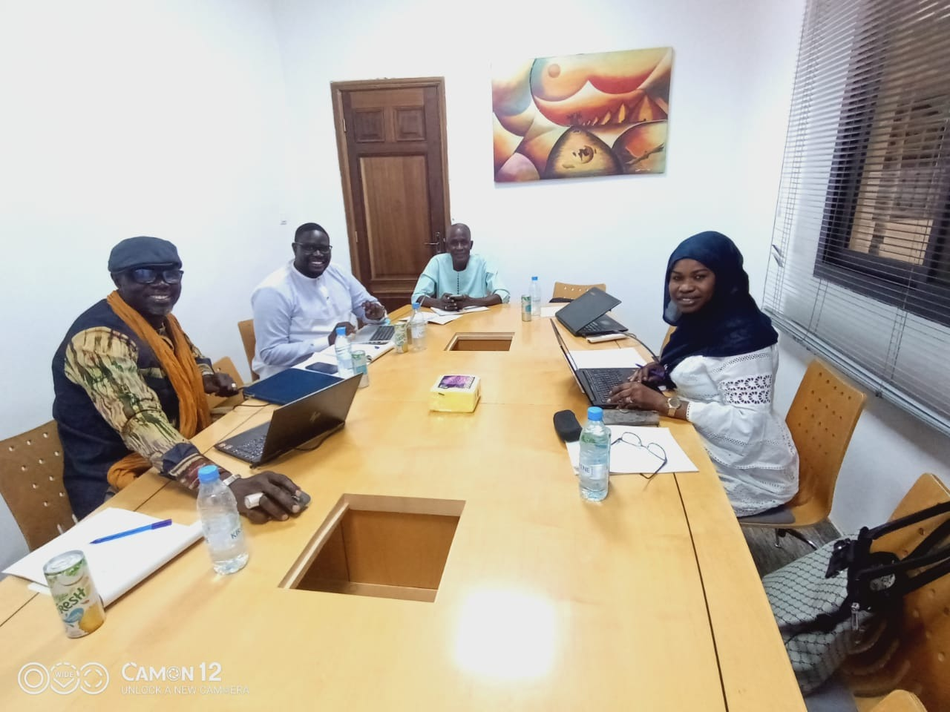
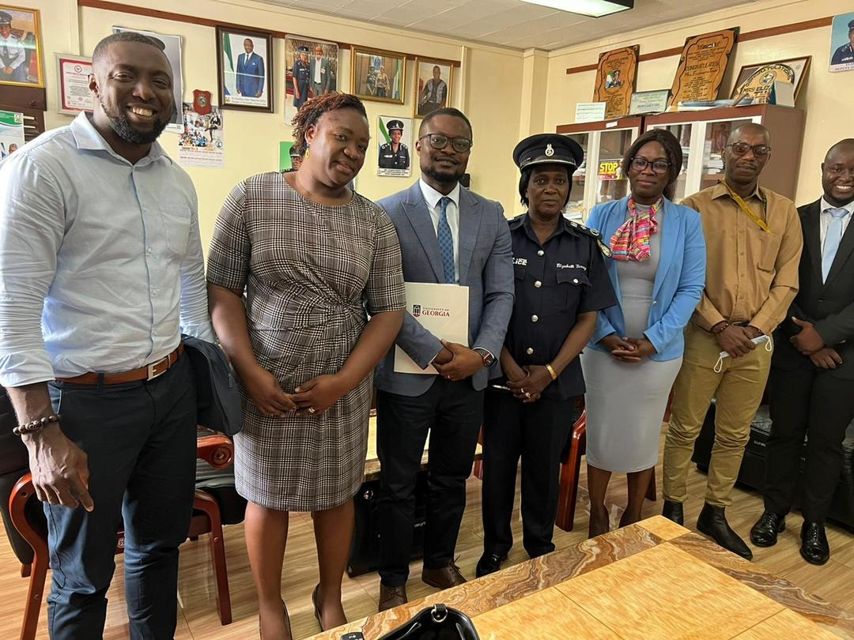
The CenHTRO Team in West Africa
14

Slide 15

Thank you
Q & A

